Slide 1


Review CodingSecure

Slide 2

What is secure coding?
Secure coding is the practice of developing software that is resistant to security vulnerabilities by applying security best practices, techniques, and tools early in development. Instead of thinking only about user experience, secure coding aligns every feature with security measures—right from the beginning of the software development lifecycle.
For example, an application that accepts all data from a client without sanitizing it might be easier to implement, use, and maintain. However, it opens an entry point for attackers to inject malicious code.

Slide 3
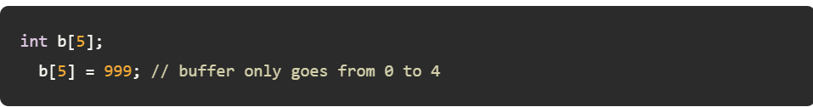
What are common code vulnerabilities?
Let’s look at common security vulnerabilities software developers and security researchers have identified. We’ll go from low-level issues like memory vulnerabilities to higher-level problems like injection attacks.
Buffer overflows
Buffer overflows can crash your application or allow attackers to write data into other buffers.
System programming languages like C/C++ are prone to this vulnerability. They allow and even require memory management explicitly but don’t check memory access until it’s too late. If you write more data into a buffer than you assigned it at definition time, C will override all memory data that follows at the end of the buffer.
Example of a buffer overflow in C:

Slide 4
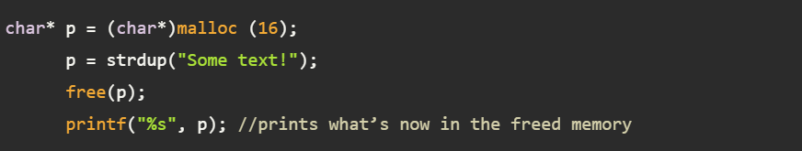
Use after free
Use after free happens when you free memory on the heap but keep using the old pointer.
Again, this vulnerability is prominent in languages without garbage collection, like C/C++, where you must manually manage memory. There are two types of memory: the stack and the heap. The language automatically manages the stack, which can’t hold data with dynamic sizes that aren’t known at compile time. The heap is for dynamic data, but you must manually allocate and free space on it. Freeing means you tell the operating system that you don’t need the memory anymore, so if you use it afterward with a pointer, the illegal access will go to an unallocated memory location.
Example of use after free in C:

Slide 5
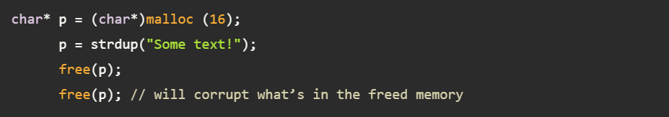
Double free
In the case of double free, you are freeing heap memory after you have already freed it.
Double free is an issue in languages with manual memory management, where you must explicitly tell the operating system that you no longer need a specific memory range. Doing so two times will result in a crash similar to the use after free issue. This usually happens when you have multiple objects with pointers to each other that get freed at some point. Double free can corrupt the memory a pointer referenced before the first free.
Example of double free in C:

Slide 6
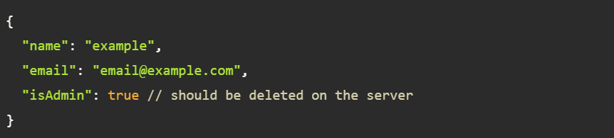
Insecure deserialization
Insecure deserialization involves directly transforming an external data structure (e.g., JSON, XML, etc.) to an internal one (e.g., objects, arrays, etc.) without sufficient checks.
Insecure deserialization is a common vulnerability in all kinds of applications. It might be good to accept unsanitized data during development, but users can sneak in malicious data without notice if it is done in production.
Example of insecure deserialization in JSON:

Slide 7
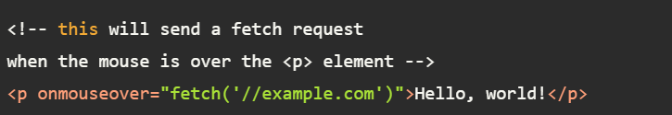
Cross-site scripting (XSS)
Cross-site scripting is a web-specific version of an injection flaw. Here, an attacker inserts custom JavaScript hidden inside HTML markup.
XSS can happen on all websites. Because markup and executable code are tightly integrated on the web, it’s easy to sneak JavaScript into HTML, which leaks sensitive data.
Example of XSS in HTML and JavaScript:

Slide 8
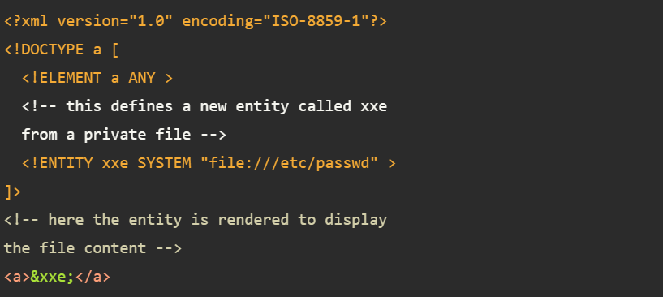
XML external entities (XXE)
XML external entities are another instance of an injection flaw. All applications that use XML are susceptible to this attack. The idea behind external entities in XML is to allow reuse of existing XML files. However, an attacker can use this feature to include links to private XML files, allowing them to read private data indirectly through their uploaded XML file.
Example external XML entity injection:

Slide 9
Code security standards
Secure coding standards are sets of guidelines and best practices that developers follow to create secure software and minimize vulnerabilities. They address common coding mistakes and weaknesses that can be exploited by attackers, aiming to create more resilient and resistant code.
Below are the common secure code standards to follow:
1. OWASP Secure Coding Practices:
OWASP Secure Coding Practices (SCP) is a comprehensive set of guidelines and recommendations for developing secure software applications. It's created and maintained by the Open Web Application Security Project (OWASP), a non-profit organization dedicated to improving software security. Here are some of key focuses:
Input validation and sanitization: Scrutinizing all user input to prevent injection attacks like SQL injection and cross-site scripting (XSS).
Authentication and authorization: Enforcing robust authentication mechanisms and restricting access to authorized users and actions.
Session management: Securing session IDs to thwart session hijacking.
Encryption: Safeguarding sensitive data using encryption at rest and in transit.
Error handling and logging: Implementing proper error handling to avoid disclosing sensitive information and logging events for security auditing.

Slide 10
2. CERT Secure Coding Standards:
CERT Secure Coding Standards (SCS) are a set of guidelines and recommendations developed by the Software Engineering Institute (SEI) at Carnegie Mellon University to help developers write secure code and prevent vulnerabilities. Key areas of focus:
Language-specific guidelines: Offering recommendations for C, C++, Java, Android, and Perl to address common vulnerabilities in those languages.
Defensive programming: Emphasizing anticipating and handling errors gracefully to prevent exploitation.
Memory management: Focus on preventing buffer overflows and memory leaks, especially in languages like C and C++.
3. NIST Secure Coding Guidelines:
NIST Secure Coding Guidelines (also known as NIST Special Publication 800-218) are a set of recommendations developed by the National Institute of Standards and Technology (NIST) to help developers write secure code and mitigate vulnerabilities. Key areas of focus:
Input validation and sanitization: Preventing injection attacks like SQL injection and cross-site scripting (XSS) by ensuring user-provided data is safe.
Authentication and authorization: Enforcing robust authentication mechanisms and secure session management.
Encryption: Using encryption techniques to protect sensitive data at rest and in transit.
Error handling and logging: Implementing proper error handling to avoid disclosing sensitive information and logging security-related events.
Memory management: Preventing memory-related vulnerabilities like buffer overflows and memory leaks, especially in languages like C and C++.

Slide 11


How to avoid common software vulnerabilities
Now that we’ve looked into the common issues, let's explore potential solutions. (If you want a more thorough resource on the topic, check out OWASP secure coding practices in this Developer Guide. It’s still a draft, but it features invaluable security tips.) Here are the top three tips for secure coding requirements:
1. Use modern languages and tools
Many memory-related security vulnerabilities affect programming languages with manual memory management and no built-in memory checks. When starting a new project, make sure you really require C/C++ for it, and if you do, use smart pointers and static code analyzers to minimize the impact of language flaws.
If you need system programming features, a more modern language like Rust can be a good choice because its type system checks memory use at compile time. Zig might also be a good alternative, as it has no hidden control flow or memory allocations.
If you don’t need system programming features, using a garbage-collected language like Java or C# can protect you from many memory issues.

Slide 12
2. Validate and sanitize input and output data
Unvalidated user data is the prime reason for injection flaws. That’s why it’s critically important to validate all data that enters your system. Sanitation is another step that can keep security in check without sacrificing usability. Instead of rejecting a user input if it’s invalid, sanitation will cut out problematic input parts (i.e., JavaScript inside HTML) and use the remaining data. When running in a client-server environment, ensure this validation and sanitation happens on the server. This means adding validators and sanitizers to all API endpoints that accept user data. It can also mean choosing data formats that are easy to validate—for example, accepting simple Markdown instead of fully-fledged HTML.
Keeping input data clean isn’t always possible; validation libraries have bugs, too. To ensure nothing leaks through to your users, only display outputs based on user inputs in a secure way (i.e., don’t render HTML).
3. Check third-party code integrity
You should consider third-party code like libraries and frameworks as inputs, too. Not inputs to your application, since libraries and frameworks essentially consist of your own and third-party code, but inputs to your build process. Always pin a specific version or hash for production deployment when using libraries. That way, no new version can sneak into your deployments unchecked.

Slide 13
Thanks
Created by Mostafa Ahmed Abas El-Ashmawy

